Slide 1
DocuSync
Team Begoonex

Slide 2


Every day, companies aim of scaling their operations with automation and SAP integration.
Their obstacle?
Manual document handling.

Slide 3
SLOW
ERROR-PRONE
COSTLY
NOT SCALABLE
PROBLEM
Manual sorting of delivery notes

Slide 4
The solution?
A lightweight, local pipeline that does the sorting and linking—automatically.

Slide 5

JSON
ID
ID
ID
BNR
BNR
BNR
BNR
PDF

Slide 6
JSON
ID
ID
ID
PDF
BNR
BNR
BNR
BNR

Slide 7
JSON
ID
ID
ID
ID
ID
ID
ID
PDF
BNR
BNR
BNR
BNR

Slide 8
JSON
ID
ID
ID
PDF
ID
ID
BNR
BNR
ID
ID

Slide 9
JSON
Name
ID
Name
ID
Name
ID
Address
Address
Address
Date
Date
Date
PDF
ID
ID
ID
ID

Slide 10
JSON
ID
ID
ID
PDF
Name
Name
Name
Address
ID
Address
Address
ID
ID
ID
Date
Date
Date

Slide 11
JSON
ID
ID
ID
ID
ID
PDF
Name
Name
ID
ID
Address
ID
ID
Address
Date
Date

Slide 12
JSON
ID
ID
ID
PDF
ID
ID
ID
ID
ID
Address

Slide 13
JSON
ID
ID
ID
PDF
ID
ID
ID
ID
ID
Address
ID
ID
AGB
2/3
1/1

Slide 14
JSON
ID
ID
ID
PDF
ID
ID
ID
ID
ID
ID
ID
Address
AGB
2/3
1/1

Slide 15

JSON
ID
ID
ID
PDF
ID
ID
ID
ID
ID
ID
ID
Address
AGB
2/3
1/1

Slide 16
JSON
ID
ID
ID
PDF
ID
Header
ID
ID
ID
ID
ID
ID
Address
AGB
2/3
1/1

Slide 17
TECHNOLOGY OVERVIEW
EARTH
Light weight scritp
JUPITER
VENUS
MARS
MERCURY
Earth is the only planet known to harbor life
Jupiter is the biggest planet of them all
Venus is the second planet from the Sun
Despite being red, Mars is actually a cold place
Mercury is the smallest planet of them all

Slide 18
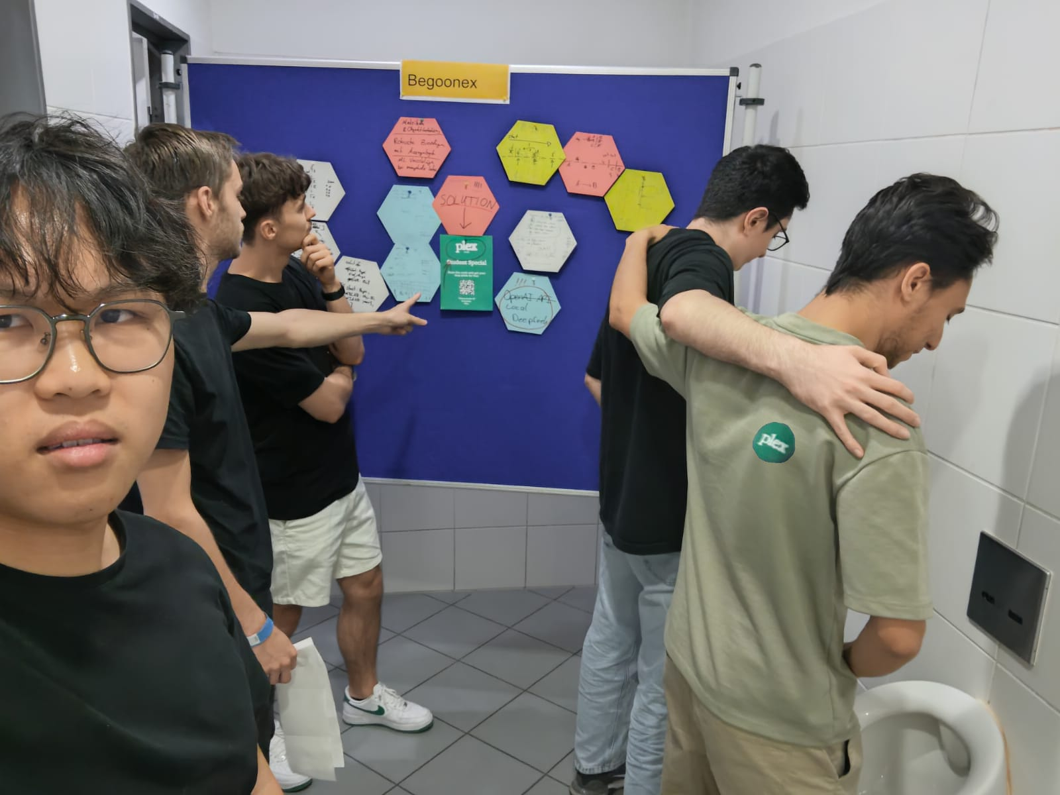
THANKS!

